Slide 1
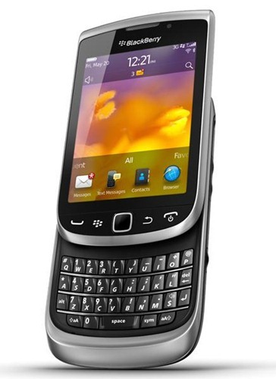
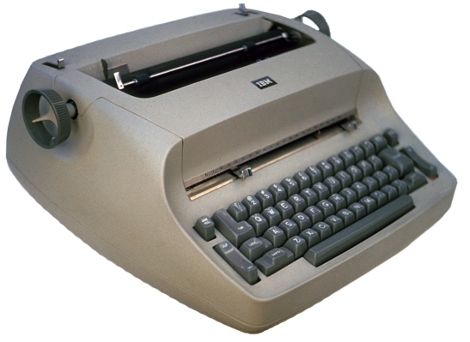
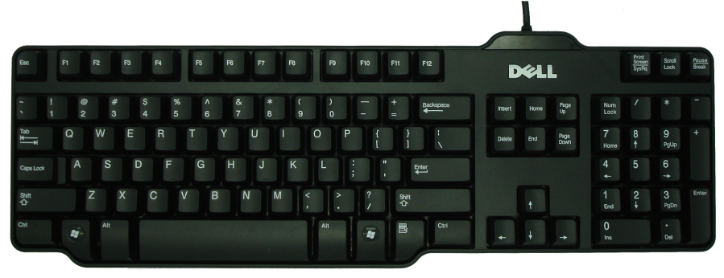
What is the QWERTY Keyboard?
QWERTY is the acronym that commonly describes today’s standard keyboard layout on English-language computers. QWERTY is derived from the first six keys (from left to right) on the far left portion of a standard keyboard just below the number keys. Patented in 1874 by Christopher Sholes (the inventor of the typewriter), the QWERTY design first appeared in typewriters. The QWERTY layout was designed to prevent people from typing too quickly and jamming various keys on early typewriters as they moved to strike the paper. August Dvorak in 1932 tried to improve the standard QWERTY keyboard configuration with what he believed was a more efficient layout. While he placed vowels and the five most common consonants in the middle row, QWERTY still remains the standard through today.
Dvorak’s Keyboard Layout
http://site.xavier.edu/polt/typewriters/tw-history.html

